Slide 1
FUNNEL ANALYTICS
E-COMMERCE FUNNEL ANALYSIS
29%
REVENUE LEAK
Portfolio Project · 5,000 Orders · 2023–2024
EXCEL · POWER BI · DATA CLEANING · FUNNEL ANALYSIS
Notes:
Portfolio project: an end-to-end e-commerce funnel analysis of 5,000 orders, built in Excel and Power BI.

Slide 2
FUNNEL ANALYTICS
Project Overview
WHAT I BUILT
TOOLS USED
Analyzed 5,000 e-commerce orders across 800 unique customers and 15 actively ordered products.
XL
Excel
Data cleaning, pivot tables, charts
Goal — map the full order lifecycle, from placement to delivery, and identify where revenue was being lost.
BI
Power BI
Interactive dashboard with slicers
Scope — Electronics, Clothing, and Home & Kitchen categories across 2023–2024.
CSV
Source Data
5,000 orders + 20-product catalog
Notes:
Scope of the project and the toolchain used end to end.

Slide 3
PART ONE
DATA CLEANING & PREPARATION
01
Building a trustworthy foundation before any analysis
Notes:
Section break: everything downstream depends on trusting the data.

Slide 4
Data Cleaning — What I Checked
CHECK
FINDING
ACTION
✓
Duplicate rows & order IDs
None found
No action needed
✓
Null / missing values
Size column: 17 products stored “N/A” as text
Preserved as intentional string — not a real null
✓
Referential integrity
All order product IDs matched catalog
No action needed
✓
Date sequencing
No shipping dates before order dates
No action needed
!
Unordered products
5 products (Sports, Books) had zero orders
Retained — catalog must stay complete
Notes:
Five checks, each with the finding and the action taken. Note the deliberate no-fabrication choices.

Slide 5
PART TWO
FUNNEL ANALYSIS & KEY FINDINGS
02
Mapping the order lifecycle to find revenue leaks
Notes:
Section break: from clean data to the findings.

Slide 6
Dataset at a Glance
5,000
800
15
3
TOTAL ORDERS
UNIQUE CUSTOMERS
ACTIVE PRODUCTS
CATEGORIES
ORDER STATUS DISTRIBUTION
Delivered
43.3%
Cancelled
14.7%
Returned
14.3%
Processing
14.0%
Shipped
13.7%
Notes:
The shape of the dataset, and the order status split that sets up the leak story.

Slide 7
Revenue by Category
68%
Electronics
68%
$835K estimated revenue
of total revenue comes from Electronics alone
Clothing
19%
Concentration risk — one category dominates the revenue mix
$233K estimated revenue
Home & Kitchen
13%
$159K estimated revenue
Notes:
Electronics carries 68% of revenue — the single biggest structural risk in the mix.

Slide 8
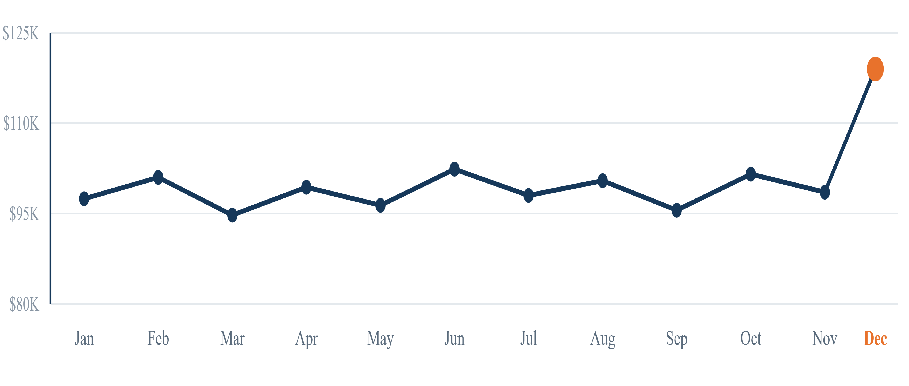
Monthly Revenue Trend
+21%
MOM DECEMBER SPIKE
Flat year-round at roughly $95–105K per month, with a single December lift.
Notes:
Revenue sits in a narrow band all year; December is the only real break in the pattern.

Slide 9
Payment Methods & Revenue Loss
PAYMENT METHOD SPLIT
Apple Pay
20.6%
REVENUE LOST TO DROP-OFFS
Debit Card
20.2%
29%
PayPal
19.9%
of orders end as returns or cancellations
Credit Card
19.7%
14.7%
Google Pay
19.6%
Cancelled
14.3%
Returned
An even five-way split — payment method is not a driver of drop-off.
14.0%
Processing (unrealized)
13.7%
Shipped (unrealized)
Notes:
Payment mix is evenly split — no lever there. The revenue story is in the drop-offs.

Slide 10
PART THREE
BUSINESS RECOMMENDATIONS
03
Turning findings into actionable next steps
Notes:
Section break: what the business should do about it.

Slide 11
Three Data-Backed Recommendations
01
02
03
Fix the 29% Revenue Leak
Reduce Category Concentration
Build a Mid-Year Revenue Plan
Returns (14.3%) plus cancellations (14.7%) mean 29% of orders never convert to realized revenue. Investigate whether they cluster around specific products, price points, or fulfillment delays — closing this leak returns more than any new acquisition spend.
Revenue is flat from January through November at roughly $95–105K per month. A Q2 and Q3 promotional campaign would reduce December dependency and smooth cash flow across the year.
Electronics carries 68% of revenue — a fragile single-category dependency. Clothing and Home & Kitchen need targeted promotional investment to build a revenue cushion and reduce exposure.
Notes:
Three recommendations, ordered by expected revenue impact.

Slide 12
Project Deliverables
POWER BI DASHBOARD VISUALS
EXCEL WORKBOOK TABS
KPI Cards
Revenue, orders, avg order value, customers
Orders Data
5,000 cleaned rows with category merged in
Order Funnel
Lifecycle from Processing → Delivered
Products Data
Full 20-row product catalog
Category Donut
Electronics concentration vs. other categories
Summary Tables
Order status, category revenue, payment split, monthly trend
Monthly Trend
Order volume and revenue, Jan–Dec 2024
Charts Dashboard
Six embedded Excel charts
Revenue by Status
Revenue realized vs. lost per status
Payment Split
Order count by payment method
Every figure in this deck traces back to a summary table in the workbook — no numbers were estimated outside the source data.
Slicers
Year, category, status — cross-filter all visuals
Notes:
What was actually shipped: the Power BI file and the Excel workbook behind it.

Slide 13
Skills Demonstrated
Data Cleaning
Exploratory Analysis
Excel Proficiency
Null handling, referential integrity checks, date validation, defensive trim, no-fabrication principle
Order status distribution, category segmentation, payment method analysis, monthly trend identification
Pivot tables, embedded charts, multi-tab workbook organization, summary table design
Power BI
Business Insight
Documentation
Interactive dashboard with slicers, cross-filtering, KPI cards, funnel, donut, line and bar charts
Translated raw data into three actionable recommendations tied to revenue impact
GitHub README, cleaning audit trail, and a visual guide for every deliverable
Notes:
The capability map behind the project.

Slide 14
PART FOUR
POWER BI DASHBOARD PREVIEW
04
Interactive dashboard with slicers, KPI cards, funnel analysis, and category breakdown
Notes:
Section break into the live dashboard walkthrough.

Slide 15
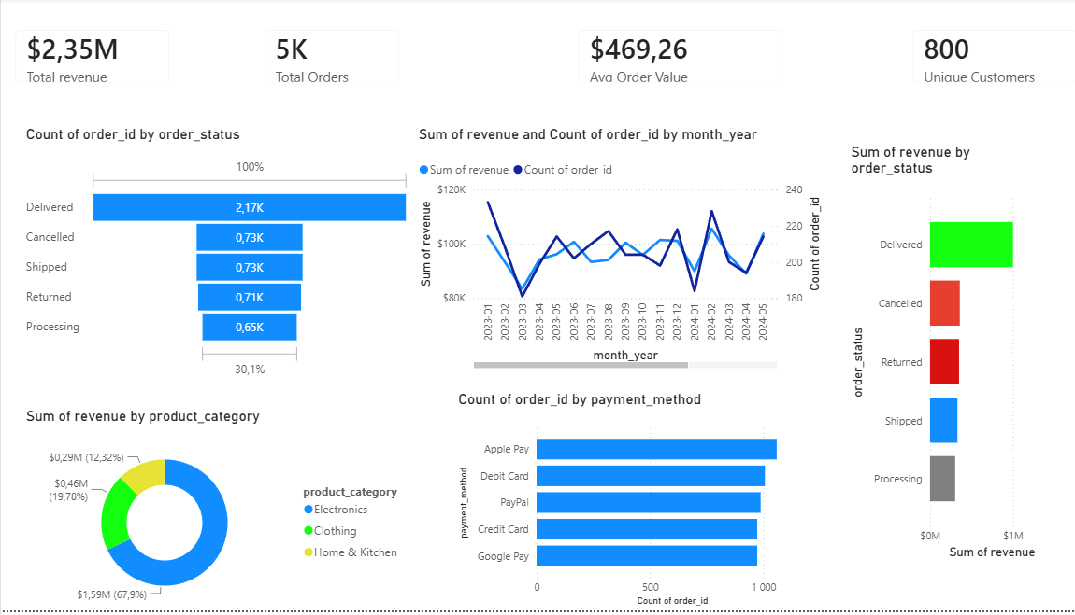
E-Commerce Funnel Dashboard — Power BI
KPI CARDS · ORDER STATUS · MONTHLY TREND · CATEGORY · PAYMENTS
Notes:
Walk the dashboard: KPI cards top, funnel left, trend centre, category and payment splits below.

Slide 16
THANK YOU
E-Commerce Funnel Analysis · Portfolio Project
5,000
800
15
3
ORDERS ANALYZED
CUSTOMERS
PRODUCTS
RECOMMENDATIONS
EXCEL · POWER BI · NO-CODE ANALYSIS · BUSINESS STORYTELLING
Notes:
Close: recap the scope and invite questions.

